Slide 1
Army Net-Centric Data Strategy (ANCDS) Center of Excellence (CoE)
Pam Ludwig
Jan O’Malley Omalley_Jan@bah.com
CBM+ Files and Messages Workshop
June 12-14, 2012

Slide 2
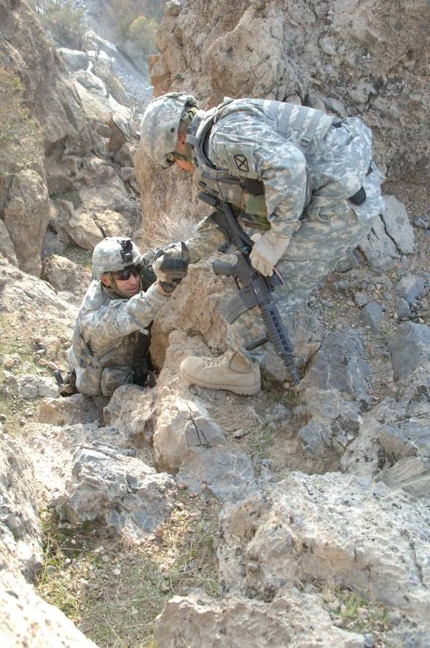
Army Net Centric Data Strategy Center of Excellence
ANCDS is aligned with DoD Directive 8320.02
Strategy for enterprise services enables secure information sharing and supports timely, effective, and accurate decision-making
ANCDS CoE Mission Statement
Function as the center of development, adoption, implementation and sustainment efforts of the Army’s Net Centric Data evolution
ANCDS Center of Excellence offers several resources:
Guidance and Best Practices
Repeatable Processes
Tools and Pilots
Subject Matter Expertise
SEC Chartered, since 2007
by DA CIO/G-6 as a
Center of Excellence.
2

Slide 3
CIOs, PEOs, and PMs are under pressure to reduce costs and also increase mission performance
TODAY’S PRESSURES
…lead to…
COMMON QUESTIONS
Reduce Costs
Budget Control Act of 2011, potential reductions, need for efficiencies
Increase Mission Performance
Missions constantly evolve, user requirements change, new commercial solutions come available, new platforms / technologies emerge
More agile, more responsive, shorter release cycles
Smarter Cuts
How can I reduce IT system development and sustainment costs while increasing mission performance?
How can I reduce IT system support costs? (Training, field support reps)
Where are the redundancies in my IT system portfolio and what should I cut (or transition)?
How do I best govern cost cutting and mission optimization initiatives from an enterprise perspective?
Smarter Systems
How do current systems support the current mission? Future mission?
Where are the gaps in my mission needs and what services should I acquire or build?
How do I best integrate what’s left after cuts?
How can I take a data-driven, quantitative based approach to determine the best course of action?

Slide 4
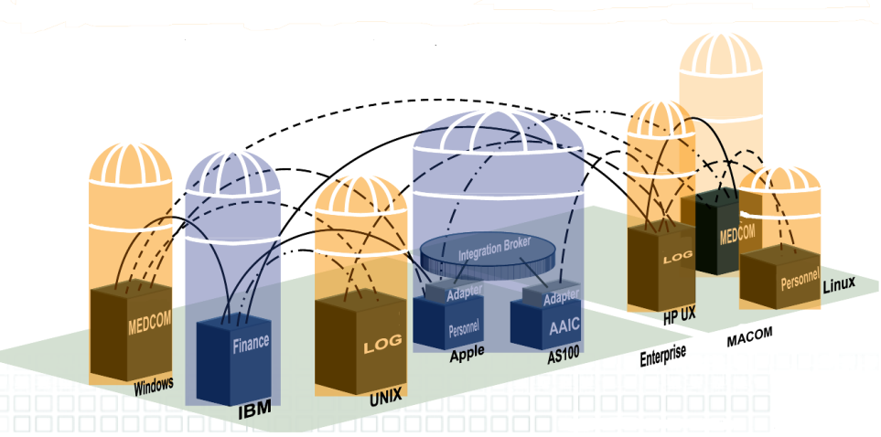
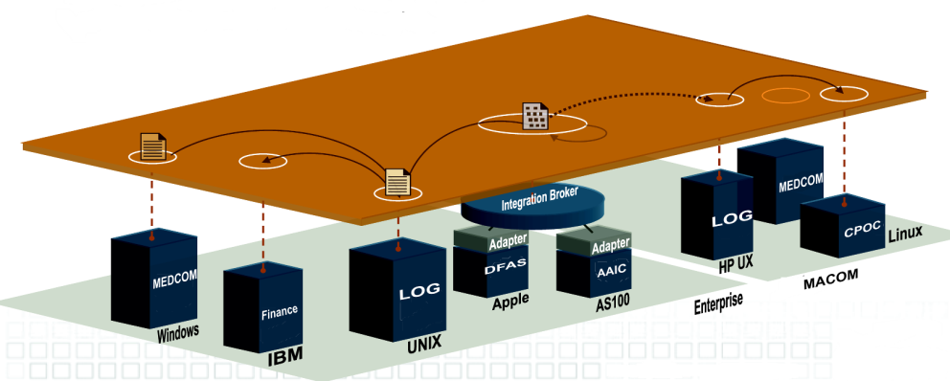
Data Strategy – Current/Future
Where We Are
Data is not easily visible, with limited authoritative source(s) identified for Army data
Data is not easily accessible, with complexity of inter-organizational collaboration hinders data sharing
Data is not easily interoperable with pair wise integration
Where We Want To Be
Discoverable and authoritative data sources
Easily defined and updated business processes and accessibility agreements
Standardized specifications and re-usable data exchanges
Data Services Layer

Slide 5

Smarter Cuts, Smarter Systems
With constantly changing mission needs and budget pressures…
…there is a better way for CIOs, PEOs, and PMs to acquire / develop and sustain systems...
CAPABILITIES
…that results in both reduced overall costs
and…
…increased mission capabilities through enterprise integration.
COST

Slide 6
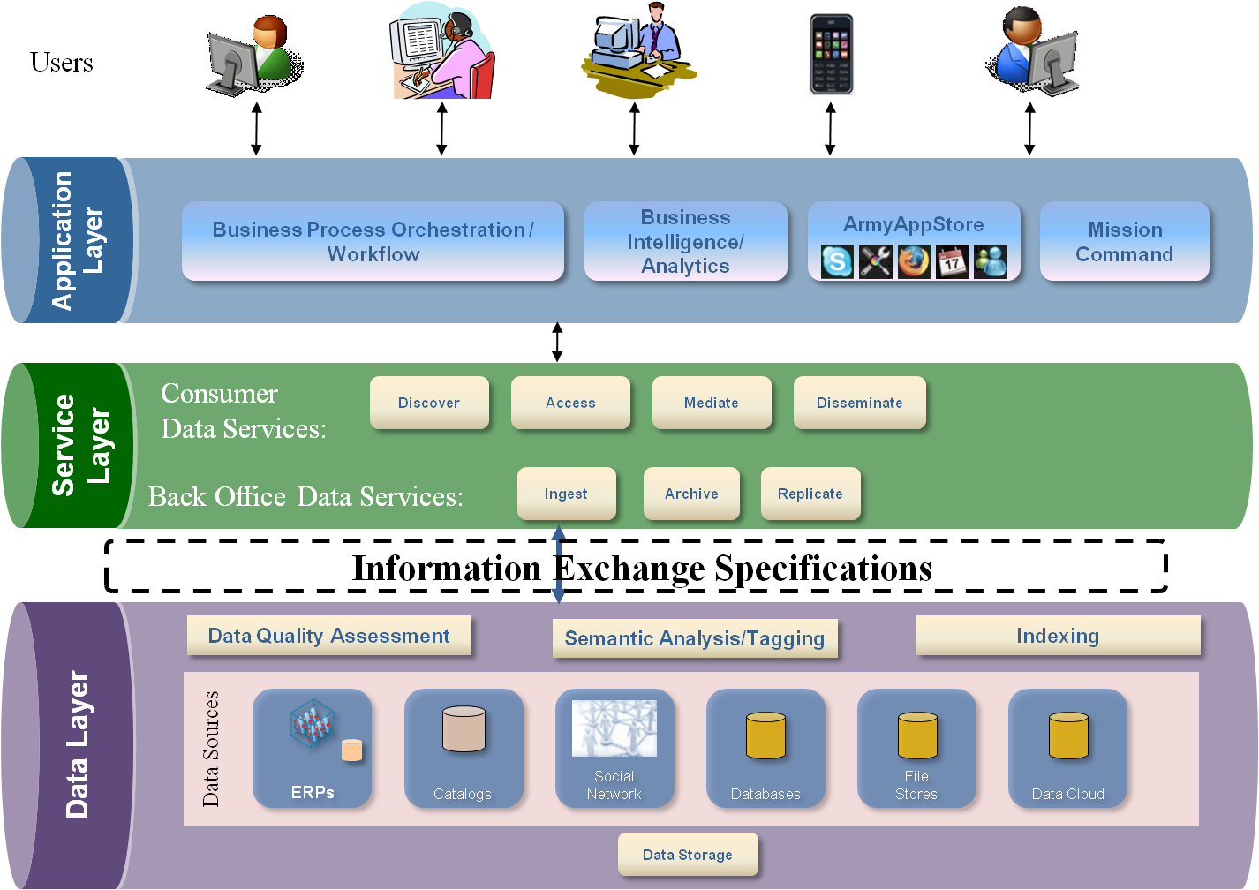
AIA SOA/Data Architecture End-State
Data Enriched Applications
Increase ability to access, interoperate and inform by sharing data in a timely and secure manner
Support more effective and efficient decision making
Provide enterprise data sharing environment that is less costly to design, develop, and deploy
Standard Data Services
Access Diverse Data Stores via a layer of Standards-based Data Services
Decouple applications from data
Allow applications to discover previously unavailable data
Information Exchange Specifications
Interoperate using Information Exchange Specifications (IESs) within or among Communities of Interest to enable better understanding of shared information
Diverse Data Stores
Enable all data, structured, semi-structured and unstructured, to be stored, processed, and retrieved

Slide 7
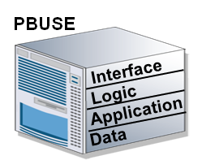
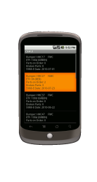
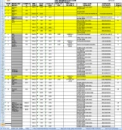









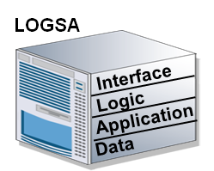





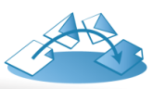





Data Services – How do they help?
Task Force Falcon: What’s My Division’s Maintenance Status?
Current Way
Data Service Way
After Days the answer is:
- 65% of the vehicles are up - as of yesterday.
After Hours the answer is:
73% of the vehicles are up, right now;
10% are down due to tire damage,
Mechanics are on site, parts will arrive tomorrow.
Fleet has a estimated time to failure (ETF) of 150 hrs
Data exposed to new portals, dashboards, mobile
SAMS-E
Time Delay
_{Final}
_{Report}
_{Excel}
Data Service 1
Data Service 2
Data Service 3
Service 3= Service 1 + 2
Organization
Part Order
MOS Location
_{Word}
_{PPT}
Common Operating Environment
_{Radio Calls}
Authoritative Data
_{SAMS-E}
PBUSE
CBM+
BFT
_{Unit}
_{Information}
Notes:
7
A Data Service is a type of web service, optimized for the real-time data integration demands of Service Oriented Architecture (SOA).
Data Services enable distributed discovery, access, and consumption of data across platforms and organizations, regardless of where the data resides, data type, and/or technical implementation.
Data Services:
Decouple physical and logical locations and avoid unnecessary data replication.
Abstract physical data structures and syntax into a common view.
Federate disparate data into useful composites.
Support data integration across both SOA and non-SOA applications.

Slide 8
Data Services Layer – Army (DSL-A)

Slide 9


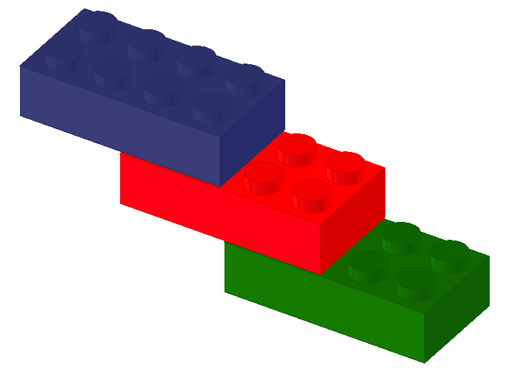

Overcoming Data Challenges in a SOA Environment
Solving data challenges requires appropriate
data services strategy in a SOA environment
SOA Without Data Services Strategy
SOA With Data Services Strategy
Permits “Wild west” and stove-pipe data service design and development. | Ensures data services have common interface, behavior, and operations.
Trends toward n-squared integration costs because of variability of interfaces that impede re-use. | Reduces the Total Cost of Ownership (TCO) through service and code reuse with consistent and repeatable process.
Complicates development and maintenance of High-ROI SOA features, e.g., service composition and business process workflow. | Eases integration and use of advanced SOA features, e.g. combine the “legos” in many ways.
Increases cost for Enterprise Integration | Decreases Cost for Enterprise Integration

Slide 10
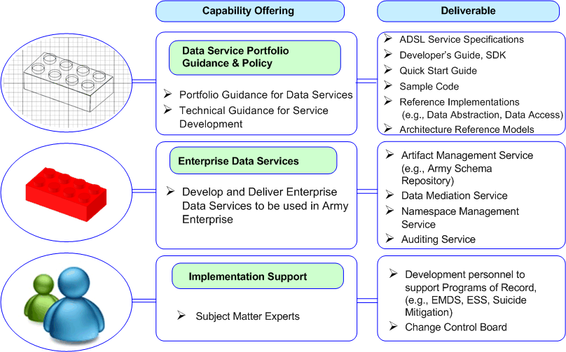
Data Services for an Effective Enterprise SOA
CIO-G/6 provides DSL-A as the standards and guidance to the Army for data services
Reduced Total Cost of Ownership

Slide 11
DSL-A Service Families and Capabilities
Artifact
Management
Data Access Audit
Data Service
Discovery
Data
Mediation
Namespace
Management
Transaction
Data Pedigree Audit
Data
Access
Data Search
Data Retrieve
Data Modify
Data Transform
Data Management
Data Governance
Artifact
Discovery
Data Integration
License Inventory
Artifact
Management
Change
Control
DSL-A SERVICES
Subscription
Data Archive
Federated
Search
Registration
View
Data
Data Report
Artifact
Certification
Retrieve
Configuration
Transform
Analyze Content
Search
Process
Modify
Process
Pattern Specification (all others are Services)

Slide 12
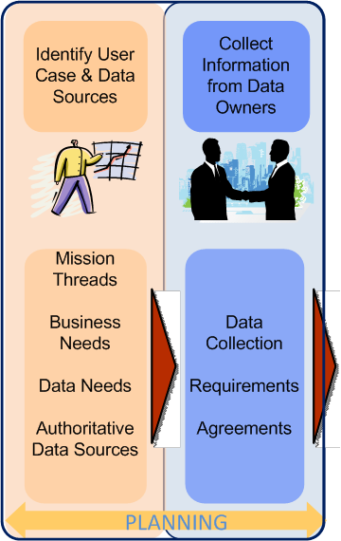
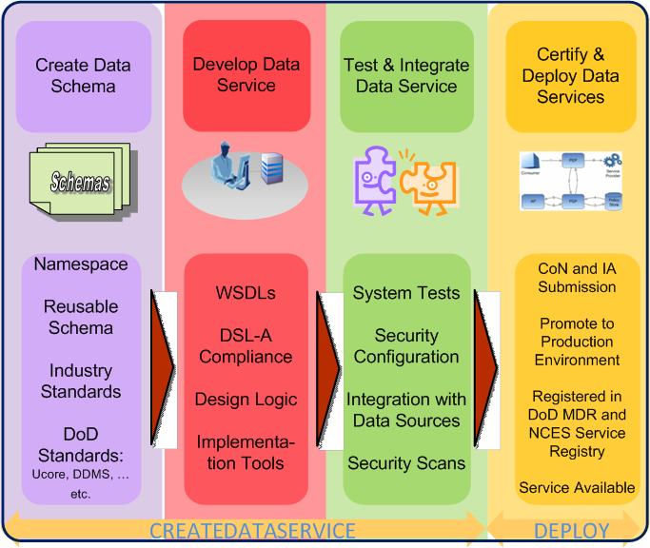
ANCDS Data Service Development Process
The Data Service Development Process is Proven and Repeatable
The Stakeholders identify categories of information, end-to-end business processes, and provide oversight
The Data Service Development Team coordinates, facilitates, and provides technical expertise to improve accessibility and exposure to designated authoritative data sources
Common, Repeatable, Proven
Implementing Data Services based on Common Information Exchange Specifications
Expanding Data Sharing Capability across the Enterprise
Notes:
This slide is to highlight that the EDSI effort is more than just infrastructure. It also incorporates a proven, repeatable process, where we have worked side by side with the Data Providers and Data Consumers from start to finish to ensure that their data sharing needs and expectations are successfully met. The Information Architecture and Data Service Layer has been briefed to the ARFORGEN Business Architecture Working Group and adopted as a logical approach to web service development supporting the ARFORGEN. Discussions are also taking place with AMC and IMCOM on implementing the approach. This approach has also been used for data services development by the Suicide Prevention Task Force and internally within the Software Engineering Center.

Slide 13
ANCDS Customer Examples
Health Promotion Risk Reduction (formerly the Suicide Prevention Task Force)
TS3: US Public Health Command, MEDCOM (TS3), DAMIS, DCIPS, ITAPDB , ATRRS, ACR, COPS (upcoming) – completed in 6 months
CDSF: ATRRS (4 months), ACR (3 months), COPS (TBD – in progress)
Enterprise Data Sharing Initiative / Enterprise Management Decision Support (Unit Readiness)
Condition Based Maintenance Plus (CBM+)
C2 Data Sharing Pilot (DDS/PASS, JC3IEDM, etc.)
Several SEC Internal projects
Example integrated technologies:
Dashboards
Data Warehouses / ETL Tools
Asynchronous Messaging
Android Devices
Notes:
MEDCOM: Medical Protection System
DAMIS: Drug Alcohol Management Information System
DCIPS: Defense Causality Information Processing System
ITAPDB: Army Human Resources Database
ATRRS: Army Training Requirements and Resource System
ACR: Army Central Registry (abuse)
COPS: Army Correctional Information System

Slide 14
How does this apply to CBM+?

Slide 15
Focus to Date
Our efforts to date have focused on
Generating the data
Transporting the data
Indexing the data
Storing the data
It’s time to talk about
Using the data

Slide 16
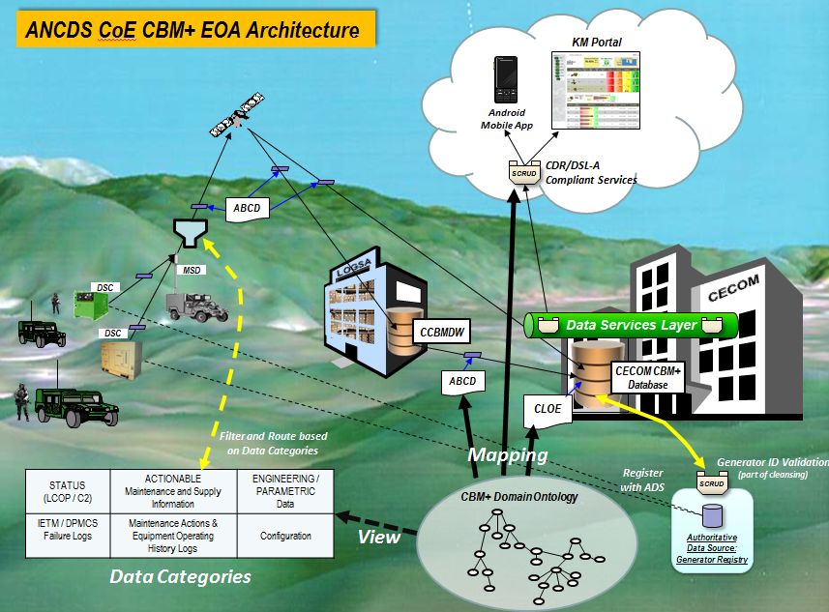
Use of Data Services in CBM+ EOA Architecture

Slide 17
As it Architecture for CBM+ Data Usages
Disadvantages:
Not standardized
Not automated
Not reusable
Users
Application Layer
Bulk File Retrieval UI
Bulk File Transfer
Data Layer
Enterprise Data Assets
Catalogs
CCBMDW
ABCD Files
CIMS
LOGSA
Platform

Slide 18

To Be Architecture for CBM+ Data Usage
Users
Application Layer
Business Intelligence/ Analytics
CBM+ UI Apps
CBM+ Apps using BODs
Service Layer
Consumer (Enterprise and Provider) Data Services:
Discover
Access
Mediate
Disseminate
Modify
Ingest
Archive
Replicate
Back Office Data Services:
Enterprise Data Assets
CBM+ Parametric Data
Data Layer
Bulk File Transfer
ABCD Files
CIMS
Catalogs
CCBMDW
Platform
LOGSA

Slide 19
To Be Architecture Advantages
Standards based access – intrinsically interoperable
Data is discoverable, shareable, reusable
Process is automated
Infrastructure is shared
Applications are enterprise resources

Slide 20
Recommendations
Use AIA architecture to make sensor data available to all organizations without replicating data
Consider having one central registry
Perform comparative analysis of technology for sensor data storage , including “big data”
Provide capabilities through AIA compliant web services to expose and manage sensor data and registry for different types of applications
Notes:
I don’t know what else needs to be here.

